Slide 1
On Problems Quantum Computers Can Solve Efficiently
(Submitted at FEE2026)
29/07/2026
Vu Tuan Hai, UIT-VNUHCM

Slide 2
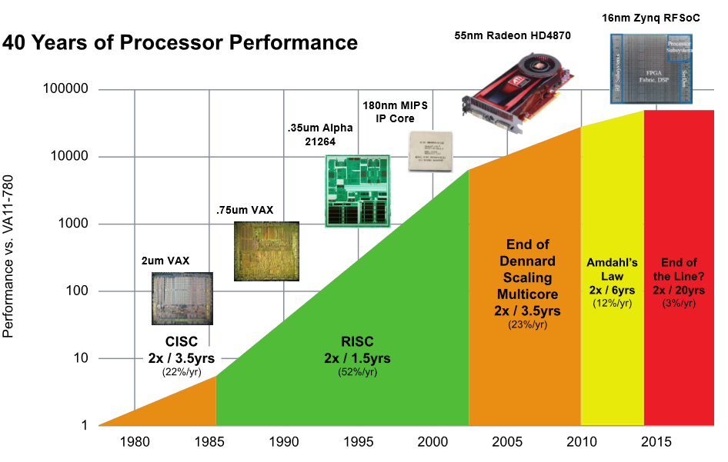
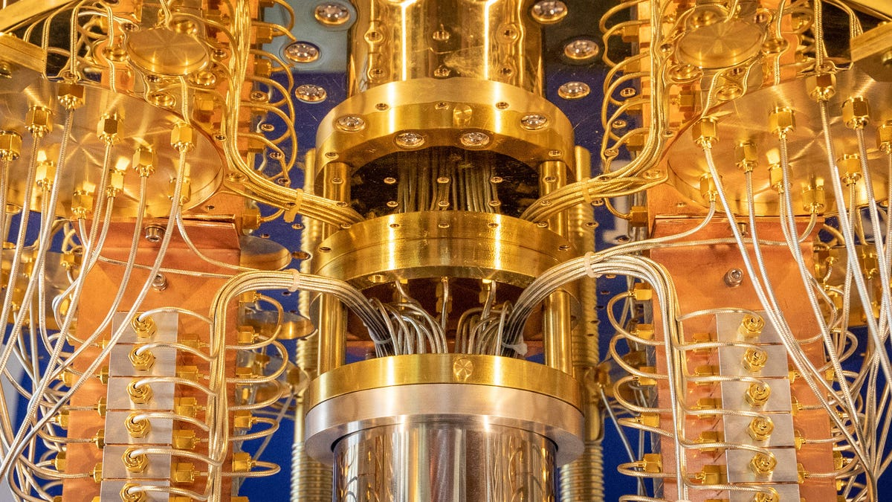
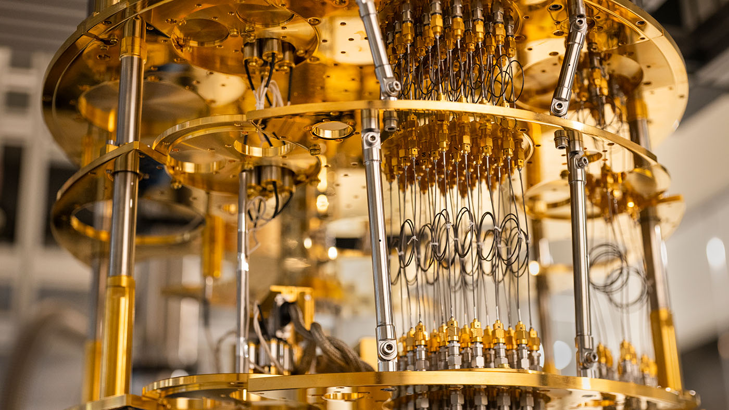
Quantum computer?
Notes:
Sức mạnh của CPU phụ thuộc vào kích thước transistor, kích thước transistor càng nhỏ, mật độ transistor trên CPU càng lớn => tính toán nhanh hơn.
Kích thước transistor hiện tại (3nm) đã gần đến kích thước lượng tử. Ở kích thước nhỏ hơn, hiệu ứng đường hầm lượng tử (quantum tunnel) sẽ xảy ra thường xuyên => tính toán sai lệch
Giải pháp thay thế: máy tính lượng tử => cứ tăng 1 qubit, sức mạnh tính toán tăng gấp đôi => tăng theo cấp số nhân và có tiềm năng lớn

Slide 3
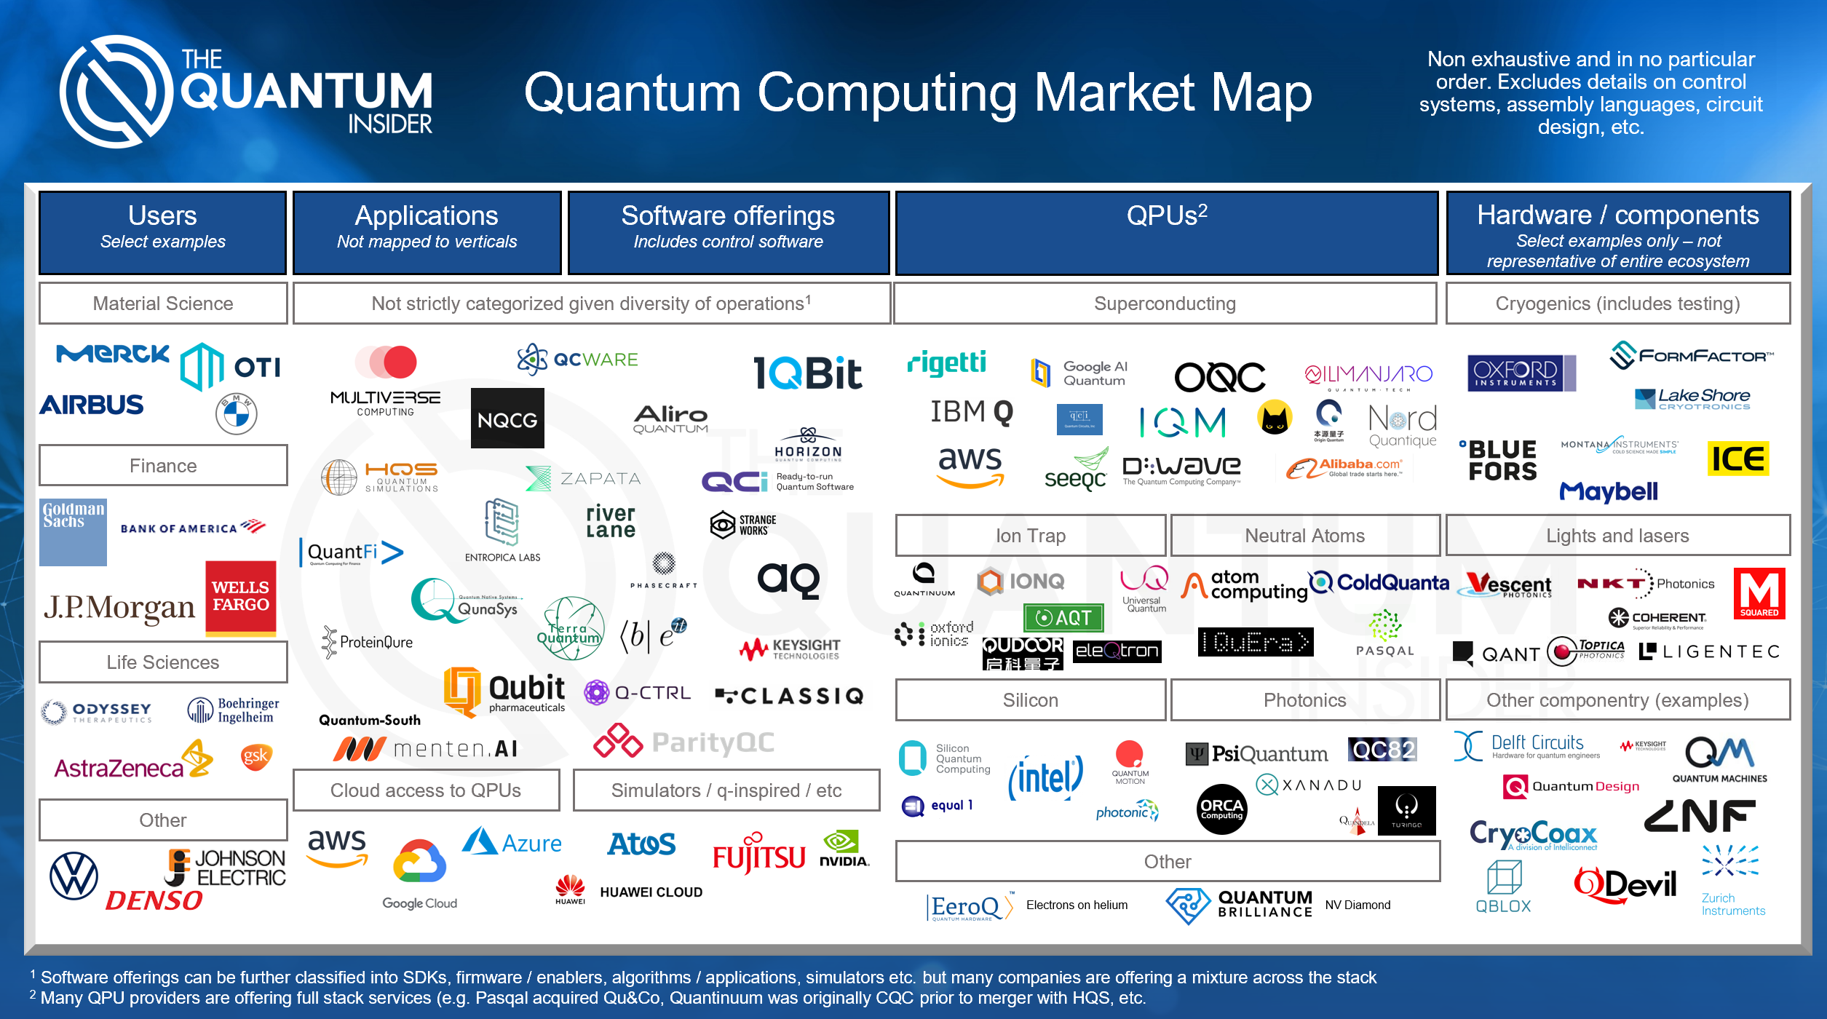
Notes:
Thị trường tính toán lượng tử hiện tại với tất cả các bên liên quan,
Đầu tư chính là JPMorgan và bank of american
AWS, GG và Microsoft đầu tư về hạ tầng, cloud, …
IBM, NVIDIA, Dwave phát triển phần cứng thật
Các nhóm nghiên cứu khác, công ty khởi nghiệp, vv, … lo hoàn thiện software, os, … phục vụ developer / researcher

Slide 4
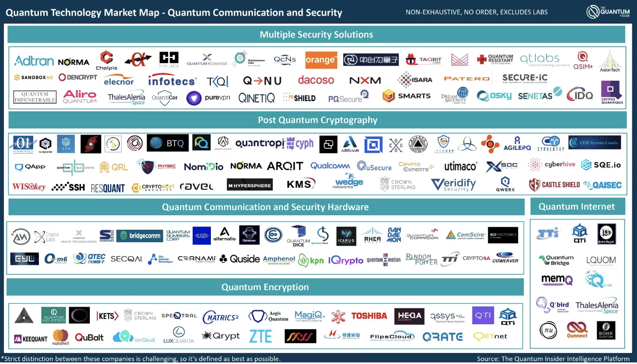

Slide 5

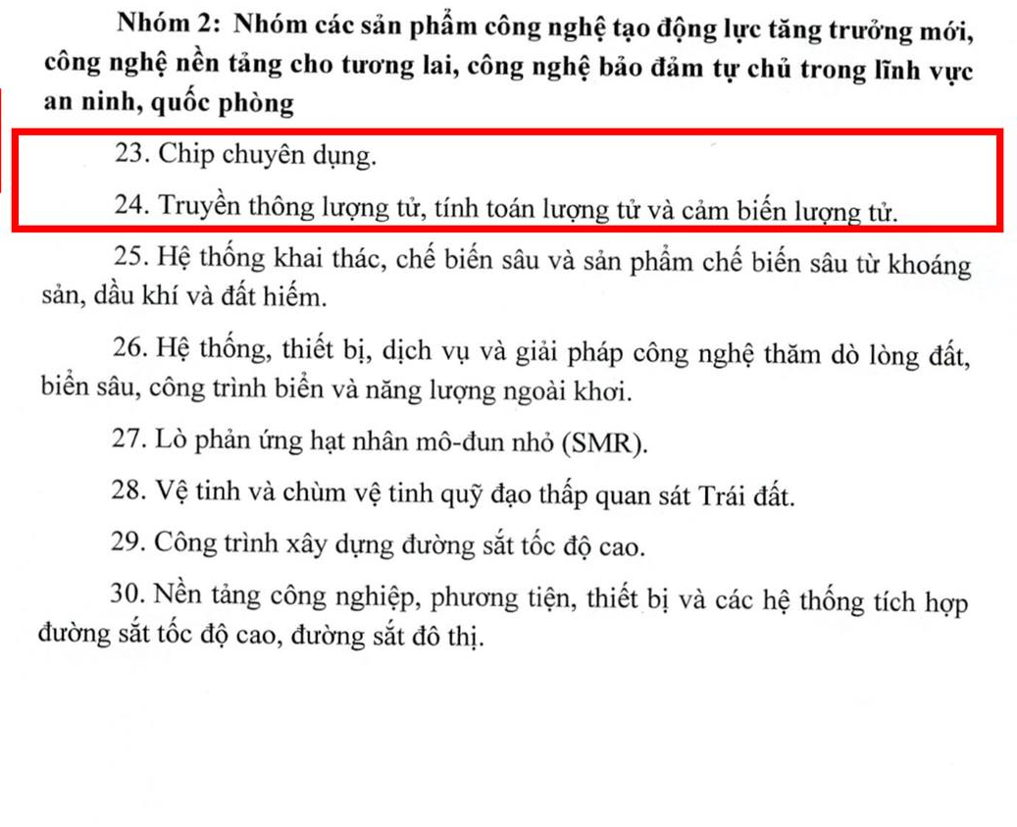
Why Quantum?
Danh mục sản phẩm công nghệ chiến lược được Chính phủ ban hành 30/4/202

Slide 6










In Vietnam

Slide 7
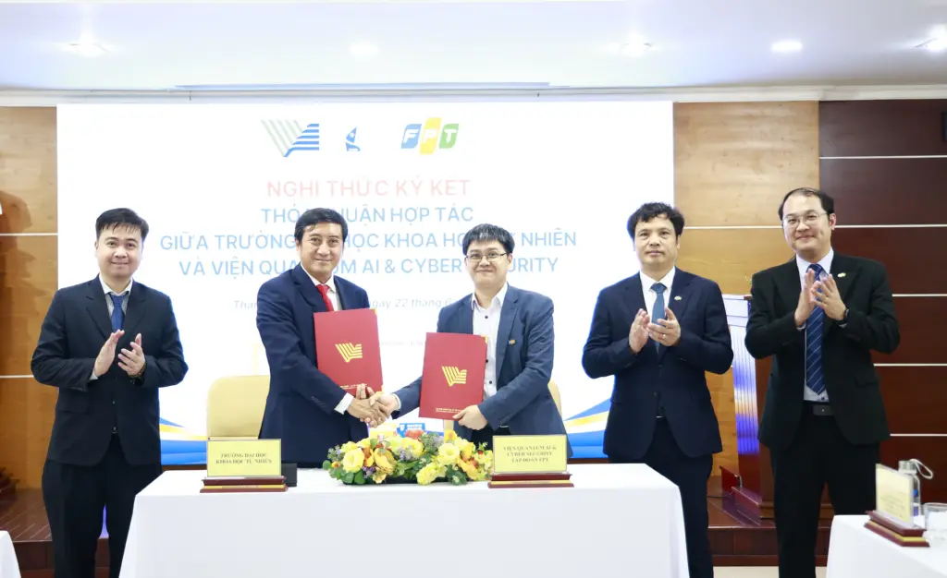
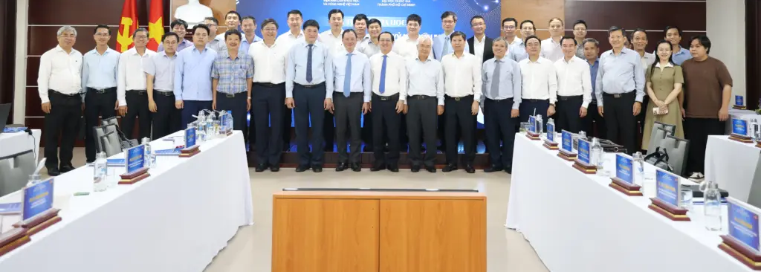
VNUHCM
HCMUS: Đề án mở ngành đào tạo thí điểm trình độ đại học ngành Công nghệ lượng tử (khoa Vật lý – VLKT)
FPT: chuyên ngành Khoa học và Công nghệ Lượng tử thuộc ngành Công nghệ Thông tin (BIT)
HCMUT: ngành Kỹ thuật lượng tử
UIT: chuyên ngành Tính toán lượng tử

Slide 8
Outline
Quantum complexity theory
Representative algorithms (Grover's search)
Sources of quantum advantage
Quantum machine learning bottlenecks.

Slide 9
1. Quantum complexity theory

Slide 10
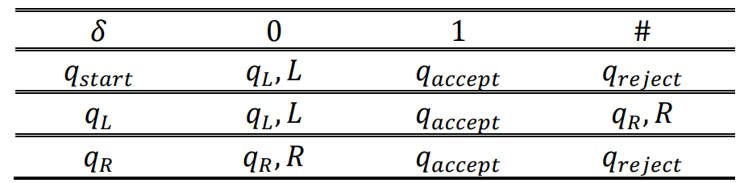


Deterministic
Deterministic Turing machine $M=\{Q,Σ,q_{start},q_{reject},q_{accept},δ\}$
$$Q=\{States\}$$
$$Σ=\left\{Alphabelt\right\}=\{0,1,\#\}$$
$δ=Q × Σ→Q × Σ × \{L, R\}$ (transition function)
Notes:
Q x xichma x {L, R} is a function

Slide 11
Nondeterministic
Guessing module
Reader
Write - only head
Read – write head
# | 0 | 0 | 0 | 0 | 0 | 1 | #
Tape

Slide 12
Nondeterministic
Nondeterministic Turing machine $M=\{Q,Σ,q_{start},q_{reject},q_{accept},δ\}$
$δ=Q × Σ→𝒫(Q × Σ × \left\{L, R\right\})$, $𝒫(S)$ denotes for power set of $S$
If the problem is solvable in polynomial time by a non-deterministic Turing machine, the problem belongs to NP class

Slide 13





Deterministic
Nondeterministic
$$f(n)$$
$$q_{reject}$$
$$q_{accept}$$
…
…
$$q_{accept}/q_{reject}$$
$$q_{accept}$$
1 computation path
n computation path

Slide 14

Example: Sub-set sum probel
Given a set S = $\{1,−2, 5,3\}$. What sub-set of S has sum equal 7?

Slide 15











Deterministic
Nondeterministic
$$\{1\}$$
$$\{1\}$$
$$\{−2\}$$
$$\{5\}$$
$$\{3\}$$
$$\{−2\}$$
…
$$\{1,5,3\}$$
…
$$\{1,−2,5,3\}$$
$$q_{accept}$$
$$\{1,−2,5,3\}$$
$$q_{accept}$$
S = $\{1,−2, 5,3\}$.

Slide 16
Polynomial number of SPACE
PSPACE
Kiểm tra lời giải trong thời gian đa thức
Nonderterministic Turing machine in Polynomial number of step
NP
coNP
complement of NP
Cho một tập hợp các số nguyên, có phải tất cả tập hợp con đều có tổng khác T không?
Cho một tập hợp các số nguyên, tồn tại hay không một tập hợp con có tổng bằng T không?
P = coP
Polynomial number of step
Tồn tại lời giải trong thời gian đa thức
Notes:
Q x xichma x {L, R} is a function

Slide 17
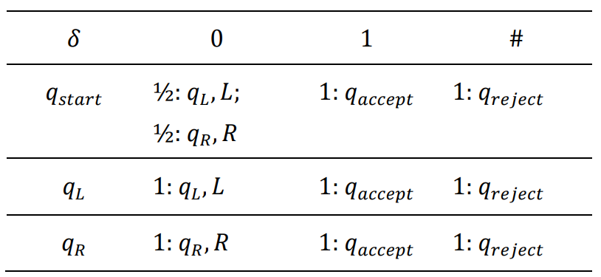
Probability
Nondeterministic Turing machine $M=\{Q,Σ,q_{start},q_{reject},q_{accept},δ\}$
$$δ=Q × Σ→{\left[0,1\right]}^{(Q × Σ × \left\{L, R\right\})}$$

Slide 18
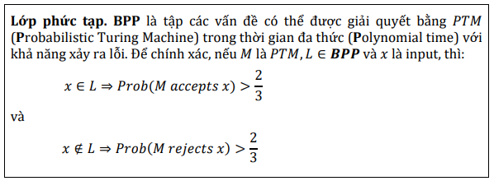
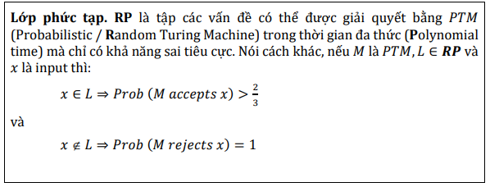









Probability
Tính hội tụ!
Lời giải đúng
Chấp nhận lời giải đúng
$$0.14$$
$$(q_{9},σ_{2},L)$$
$$0.23$$
$$(q_{17},σ_{18},R)$$
$$(q_{6},σ_{16})$$
$$(q_{17},σ_{18},R)$$
$$0.08$$
$$(q_{21},σ_{23},L)$$
$$0.55$$

Slide 19

Probability
Probabilistic Turing Machine in Polynomial time với khả năng xảy ra lỗi
BPP
Probabilistic / Random Turing Machine in Polynomial time with false negative only
Probabilistic / Random Turing Machine in Polynomial time with false positive only
RP
coRP
ZPP = RP $∩$ coRP
Probabilistic / Random Turing Machine in Polynomial time with Zero error, allow ? result

Slide 20
PSPACE
NP
BPP
coNP
RP
coRP
ZPP
P

Slide 21
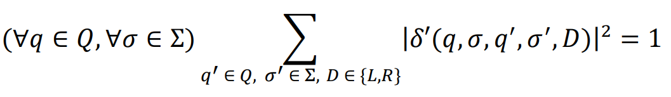
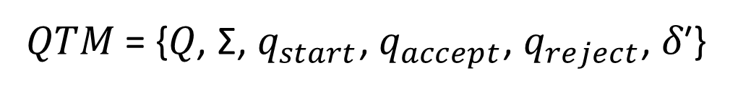

Quantum
Quantum Turing machine $M=\{Q,Σ,q_{start},q_{reject},q_{accept},δ\}$
𝑄𝑇𝑀 = {𝑄, Σ, $q_{start}$, $q_{accept}$, $q_{reject}$, 𝛿′}
𝛿′: 𝑄 × 𝛴 × 𝑄 × 𝛴 × {𝐿, 𝑅} → ℂ

Slide 22
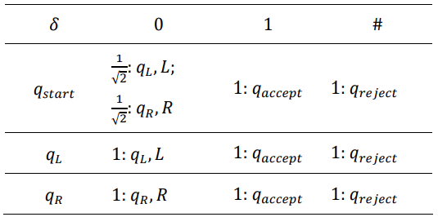
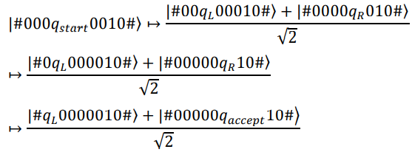
Quantum

Slide 23
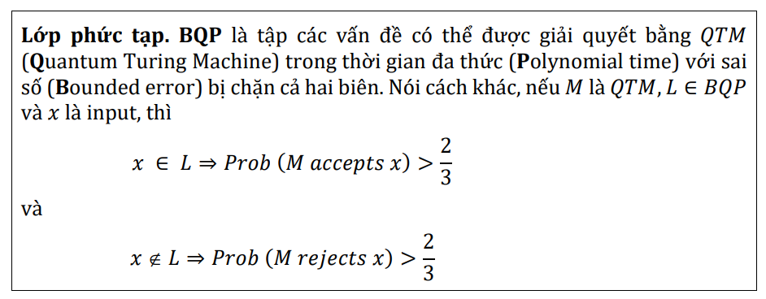
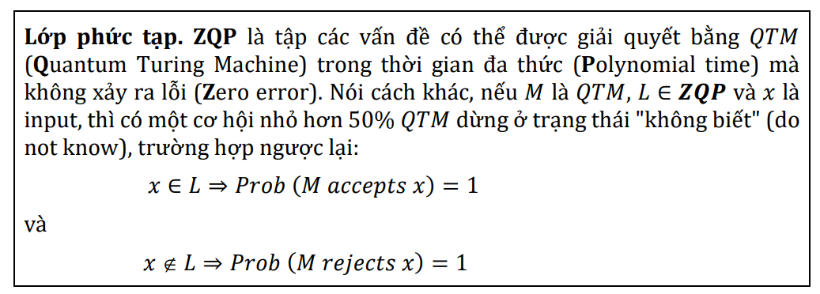
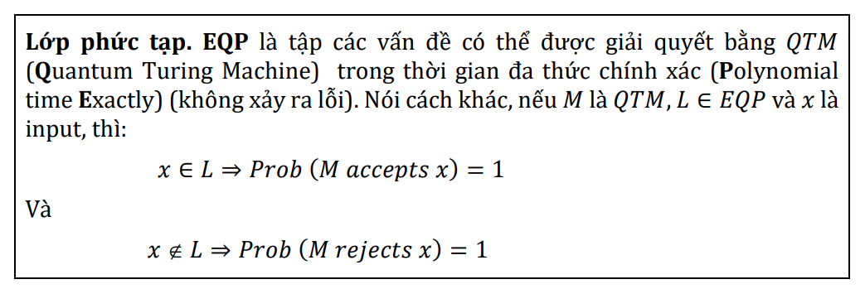
Quantum
Simon, Grover
𝑬𝑸𝑷 ⊆ 𝒁𝑸𝑷 ⊆ 𝑩𝑸𝑷
Same as ZPP
Deutsch-Jozsa,
Require only 1 query

Slide 24
Quantum
PSPACE
BQP
NP
coNP
Quantum Turing Machine in Polynomial time with Bounded error (sai số bị chặn)
BPP
ZQP
Quantum Turing Machine in Polynomial time with Zero error
EQP
RP
coRP
Quantum Turing Machine in Polynomial Exactly time with no error
ZPP
P

Slide 25
2. Grover search

Slide 26
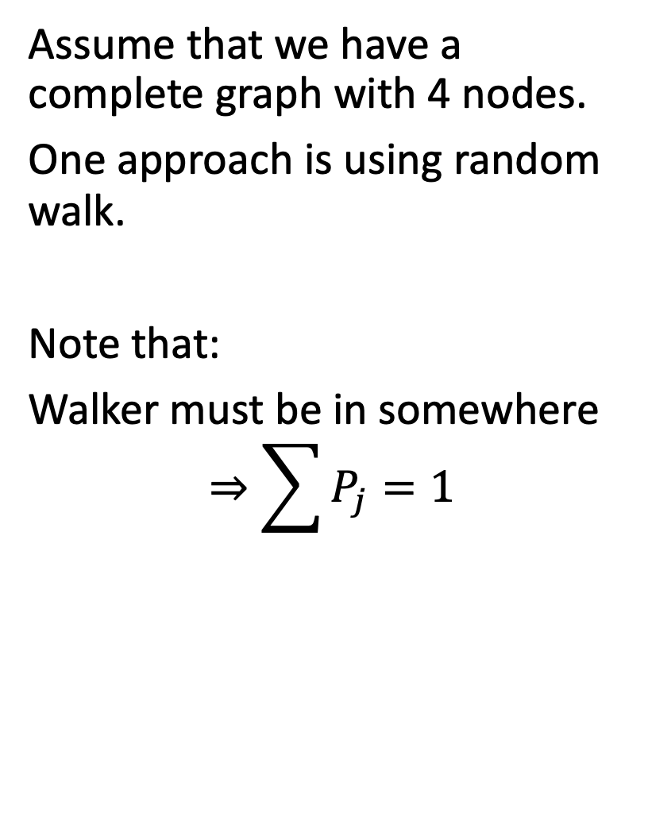
Spatial search (discrete time)
1
Assume that we have a complete graph with 4 nodes.
One approach is using random walk.
Note that:
Walker must be in somewhere
$$⇒\sum{P_{j}=1}$$
4
2
3

Slide 27
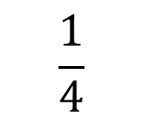

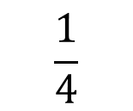
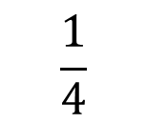
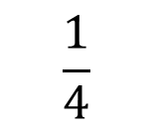
Random walk
$$\frac{1}{4}$$
1
Initial state: ¼ at all node
At step k: jump to other random nodes
$P_{1}=P_{2}=P_{3}=P_{4}=1/4$
Acts as absorb node
$$\frac{1}{4}$$
4
2
$$\frac{1}{4}$$
3
$$\frac{1}{4}$$

Slide 28
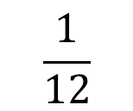
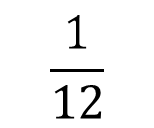
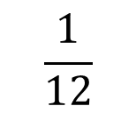
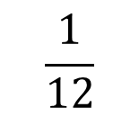
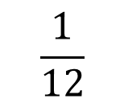
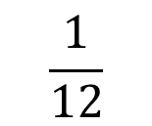
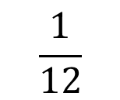
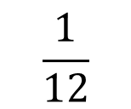
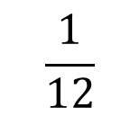
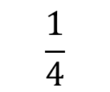
Random walk
$$\frac{1}{12}$$
$$\frac{1}{12}$$
1
At step 1:
$$\frac{1}{12}$$
$$\frac{1}{12}$$
$$\frac{1}{12}$$
4
2
$$\frac{1}{4}$$
$$\frac{1}{12}$$
$$\frac{1}{12}$$
3
$$\frac{1}{12}$$
$$\frac{1}{12}$$

Slide 29
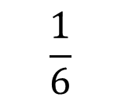
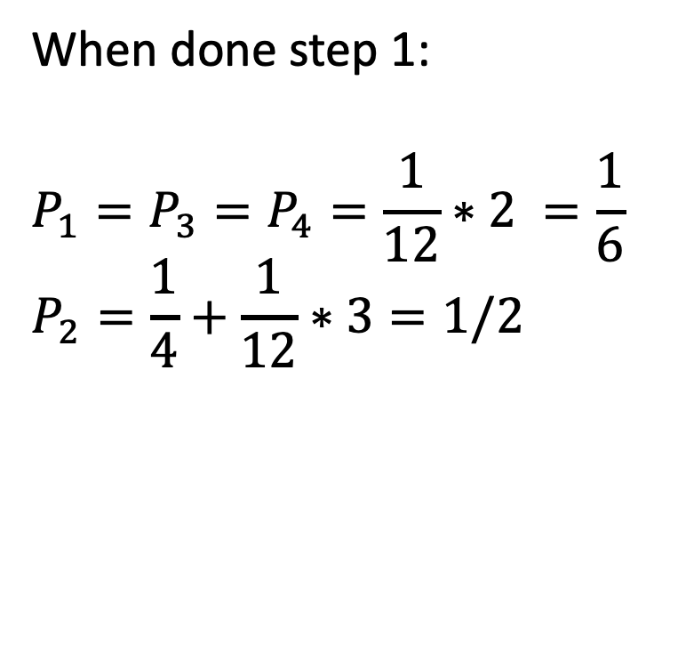
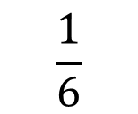
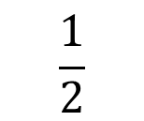
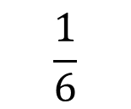
Random walk
$$\frac{1}{6}$$
1
When done step 1:
$$P_{1}=P_{3}=P_{4}=\frac{1}{12}∗2 =\frac{1}{6}$$
$$P_{2}=\frac{1}{4}+\frac{1}{12}∗3=1/2$$
$$\frac{1}{6}$$
4
2
$$\frac{1}{2}$$
3
$$\frac{1}{6}$$

Slide 30
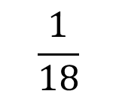
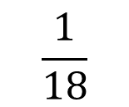
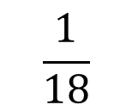
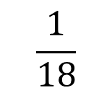
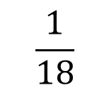
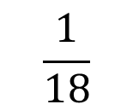
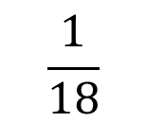
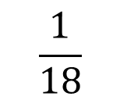

Random walk
$$\frac{1}{18}$$
$$\frac{1}{18}$$
1
At step 2:
$$\frac{1}{18}$$
$$\frac{1}{18}$$
$$\frac{1}{18}$$
4
2
$$\frac{1}{2}$$
$$\frac{1}{18}$$
$$\frac{1}{18}$$
3
$$\frac{1}{18}$$
$$\frac{1}{18}$$

Slide 31





Random walk
$$\frac{1}{9}$$
1
When done step 2:
$P_{1}=P_{3}=P_{4}=\frac{1}{18}∗2=\frac{1}{9}$
$$P_{2}=\frac{1}{2}+\frac{1}{18}∗3=\frac{2}{3}$$
$$\frac{1}{9}$$
4
2
$$\frac{2}{3}$$
3
$$\frac{1}{9}$$

Slide 32









Random walk
$$\frac{1}{27}$$
$$\frac{1}{27}$$
1
At step 3:
$$\frac{1}{27}$$
$$\frac{1}{27}$$
$$\frac{1}{27}$$
4
2
$$\frac{2}{3}$$
$$\frac{1}{27}$$
$$\frac{1}{27}$$
3
$$\frac{1}{27}$$
$$\frac{1}{27}$$

Slide 33





Random walk
$$\frac{2}{27}$$
1
When done step 3:
$$P_{1}=P_{3}=P_{4}=\frac{1}{27}∗2=\frac{2}{27}$$
$$P\left(2\right)=\frac{2}{3}+\frac{1}{27}∗3=\frac{7}{9}$$
$$\frac{2}{27}$$
4
2
$$\frac{7}{9}$$
3
$$\frac{2}{27}$$

Slide 34


Random walk
Prob(Success) at time t = $1−\frac{N−1}{N}{\left(\frac{N−2}{N−1}\right)}^{t}$
Runtime: $O(N)$

Slide 35













Quantum walk
$$α_{14}$$
1
$$α_{12}$$
Change 4 probs to 12 amplitudes of a wave function $\left|ψ\right\rangle ≔\{α_{i}\}$
Init: $|ψ(0)⟩$
Note that at intermediate steps we cannot observe the system. Then we do not know the current node is the marked node or not.
$$α_{41}$$
$$α_{21}$$
$$α_{13}$$
4
2
$$α_{42}$$
$$α_{24}$$
$$α_{31}$$
$$α_{43}$$
$$α_{23}$$
3
$$α_{34}$$
$$α_{32}$$

Slide 36














Quantum walk
At node 2: A = $\frac{−1}{\sqrt{12}}∗\frac{3}{3}$
$$\frac{1}{\sqrt{12}}$$
$$\frac{1}{\sqrt{12}}$$
1
At step 1
1a. Query oracle:
$$Q|ψ\left(0\right)⟩$$
1b. Apply a quantum coin flip+shift (-I+2A) that inverts each amplitude about the average amplitude at its vertex. (Nothing happen)
$$C(Q|ψ\left(0\right)⟩)$$
$$\frac{1}{\sqrt{12}}$$
$$−\frac{1}{\sqrt{12}}$$
$$\frac{1}{\sqrt{12}}$$
$$\frac{1}{\sqrt{12}}$$
$$−\frac{1}{\sqrt{12}}$$
2
4
$$\frac{1}{\sqrt{12}}$$
$$\frac{1}{\sqrt{12}}$$
$$−\frac{1}{\sqrt{12}}$$
3
$$\frac{1}{\sqrt{12}}$$
$$\frac{1}{\sqrt{12}}$$

Slide 37







Quantum walk
$$\frac{1}{\sqrt{12}}$$
$$−\frac{1}{\sqrt{12}}$$
1
1c. Shift operator (walk): walker at vertex i pointing to vertex j to hop to vertex j and point back to vertex i $⇒$ Swap $α_{ij}$ with $α_{ji}$.
$$SCQ\left|ψ\left(0\right)\right\rangle =|ψ\left(1\right)⟩$$
$$\frac{1}{\sqrt{12}}$$
$$\frac{1}{\sqrt{12}}$$
$$−\frac{1}{\sqrt{12}}$$
$$\frac{1}{\sqrt{12}}$$
$$\frac{1}{\sqrt{12}}$$
2
4
$$\frac{1}{\sqrt{12}}$$
$$\frac{1}{\sqrt{12}}$$
$$\frac{1}{\sqrt{12}}$$
3
$$\frac{1}{\sqrt{12}}$$
$$−\frac{1}{\sqrt{12}}$$

Slide 38

Quantum walk
$$\frac{1}{\sqrt{12}}$$
$$−\frac{1}{\sqrt{12}}$$
1
At step 2
2a. Query oracle:
$$Q|ψ\left(1\right)⟩$$
$$\frac{1}{\sqrt{12}}$$
$$−\frac{1}{\sqrt{12}}$$
$$−\frac{1}{\sqrt{12}}$$
$$\frac{1}{\sqrt{12}}$$
$$−\frac{1}{\sqrt{12}}$$
2
4
$$\frac{1}{\sqrt{12}}$$
$$\frac{1}{\sqrt{12}}$$
$$−\frac{1}{\sqrt{12}}$$
3
$$\frac{1}{\sqrt{12}}$$
$$−\frac{1}{\sqrt{12}}$$

Slide 39


Quantum walk
Reflected amp
2b. The coin inverts or reflects each amplitude about their average.
(-I+2A)
At node 1: $A=\frac{\frac{1}{\sqrt{12}}+\frac{1}{\sqrt{12}}−\frac{1}{\sqrt{12}}}{3}=\frac{1}{6\sqrt{3}}$
$$⇒α_{12}=−α_{12}+2A=\frac{5}{6\sqrt{3}}$$
$$⇒α_{13}=−α_{13}+2A=\frac{−1}{6\sqrt{3}}$$
Current amp

Slide 40













Quantum walk
$$\frac{−1}{6\sqrt{3}}$$
$$\frac{5}{6\sqrt{3}}$$
1
2c. Shift operator (walk): swap $α_{ij}$ with $α_{ji}$.
$$\frac{−1}{6\sqrt{3}}$$
$$−\frac{1}{2\sqrt{3}}$$
$$\frac{−1}{6\sqrt{3}}$$
$$−\frac{1}{2\sqrt{3}}$$
4
2
$$\frac{5}{6\sqrt{3}}$$
$$\frac{−1}{6\sqrt{3}}$$
$$\frac{−1}{6\sqrt{3}}$$
$$−\frac{1}{2\sqrt{3}}$$
3
$$\frac{−1}{6\sqrt{3}}$$
$$\frac{5}{6\sqrt{3}}$$

Slide 41











Quantum walk
$$\frac{11}{108}$$
$$\frac{−1}{6\sqrt{3}}$$
$$−\frac{1}{2\sqrt{3}}$$
1
2c. Shift operator (walk): swap $α_{ij}$ with $α_{ji}$.
$$\frac{−1}{6\sqrt{3}}$$
$$\frac{5}{6\sqrt{3}}$$
$$−\frac{1}{2\sqrt{3}}$$
$$\frac{−1}{6\sqrt{3}}$$
$$\frac{5}{6\sqrt{3}}$$
2
$$\frac{11}{108}$$
4
$$\frac{25}{36}$$
$$\frac{−1}{6\sqrt{3}}$$
$$\frac{−1}{6\sqrt{3}}$$
$$\frac{5}{6\sqrt{3}}$$
3
$$\frac{−1}{6\sqrt{3}}$$
$$−\frac{1}{2\sqrt{3}}$$
$$\frac{11}{108}$$

Slide 42




Quantum walk
Prob(Success) at time t =
Runtime: $O(\sqrt{N})$
N=4
N=100

Slide 43

3. Sources of quantum advantage
Largely it comes from superposition.
Look Deutsh-Josza algorithm

Slide 44

3. Sources of quantum advantage
Largely it comes from superposition.
Look Shor’s algorithm

Slide 45

3. Sources of quantum advantage
Total runtime = $T_{prepare}$(build a useful representation) + $T_{solve}$(find the solution).
Recent quantum algorithms: $T_{prepare}≫T_{solve}$
The right benchmark is the strongest available classical workflow, heuristics included - not an idealized worst case.
Q: “Can quantum give speedups under the same heuristic assumptions classical methods use?”

Slide 46


3. Source of Advantage: example in quantum simulation
Classical
Must store $d^{n}$ complex amplitudes explicitly.
Matrix–vector multiplication scales as $O(d^{2n})$.
Quantum
Represents the same Hilbert space with only $n$ qubits.
Under efficient block encodings, cost can scale as $O(poly(n))$; storage becomes $O(n)$.

Slide 47


3. Source of Advantage: locality and light cone
We usually solving the eigenvalue problem:
$\hat{H}c=Ec$
$\hat{H}$ is sparsity => ok, solvable on classical computer
But ${\hat{H}}^{k}$ generate a light-cone structure. We must to use resources for saving correlation information
$L_{c}∼nR_{c}$, where $n$ is the number of iterations and $R_{c}$ denotes the interaction range. Consequently, $N_{corr}∼(nR_{c})^{mD}=L_{c}^{mD}$ where $D$ is the physical dimension of the system.
The resulting quantum advantage is approximately $\begin{matrix}\frac{T_{C}}{T_{Q}}∼\frac{L_{c}^{mD}}{T_{BE}},\end{matrix}$

Slide 48

Bottleneck: Data Preparation
Classical data must first be converted into quantum state
A N – dim classical vector may need only $O(log⁡N)$ qubits.
Without QRAM, state-preparation cost can scale badly enough to eliminate any theoretical speedup entirely.
Block encoding: QSVT and Hamiltonian simulation assume a unitary that embeds a matrix — constructing it is often non-trivial and costly for dense matrices.

Slide 49




Slide 50
4. Limitations of Quantum Machine Learning
QML is one of the most actively studied topics, with many claimed advantages over classical ML.
Small-scale evidence: reported gains often come from small experiments or idealized simulations, not current noisy hardware.
Hidden data cost: many claimed speedups neglect the cost of data preparation, building the block encoding can cost more than solving the problem classically.
Idealized access: complexities like O(poly log n) frequently assume access models that hide real data-acquisition and encoding costs.

Slide 51
Which problems do quantum computers solve efficiently?
A quantum speedup must be judged end-to-end — not by the quantum portion alone.
Quantum simulation, condensed matter physics, and quantum chemistry offer the most near-term opportunities.
For QML, the bottleneck is typically converting classical data into quantum-ready form, not the circuit itself.

Slide 52




